Slide 1
New Way of RISK
Burak DÜNDAR
Notes:
Worksgop adına new way of risk dedik çünkü : New way of working, life – Yeni normal, hayatımız değişiyor.
Buna istinaden risk ler ve yöntemlerimiz değişiyor. Motivasyonlarımız değişiyor. Diğer tarafta regülasyonlar değişiyor.
Temiz masa , fiziksel güvenlik gibi kavramlar
Bugün mevcut risk yönetimi süreci yerine önemli noktaları ve risk assessment modeli konuşacağız.

Slide 2
Burak DÜNDAR
Experienced Information Security and IT GRC (Governance, Risk, Compliance) Management with a demonstrated history of working in the different verticals including international and financial services.
Information Security Management,
Information Security Assurance & Operations,
Information Risk Management,
Compliance & IT Audit Management,
Business Continuity and Disaster Recovery Management,
IT Strategy & Project Management,
Notes:
Merhaba Burak Dündar
15 yıllık bilişim sektörü deneyimi ile DFHG bünyesinde Intertech de IRM olarak görev yapıyorum.
Bugüne kadar IT ve Security alanında projelerim oldu.

Slide 3
Agenda
1
2
3
Welcome
As Is
To Be
What is Risk?
Risk Management
New Way of Risk Assessment
Notes:
Ajandamız 3 bölümden oluşuyor.
Riskler, Yönetimi ve değerlendirme

Slide 4
What is Risk?
Risk refers to a degree of uncertainty or expectation of potential damage that an adverse event may cause to the system or resources, under specified conditions. Alternatively, risk can also be defined as:
A probability of the occurrence of a threat or an event that may damage, or cause loss or have other negative impact either from internal or external liabilities.
A possibility of a threat, acting upon an internal or external vulnerability and causing harm to a resource.
The product of the likelihood that an event would occur and the impact that event would have on an information technology asset.
Notes:
Risk : Amaç ve hedefleri tehdit eden, belirli bir olasılık dahilinde gerçekleşebilecek her tür olay, koşul ya da durumun taşıdığı zarar potansiyelidir.
İç veya dış yükümlülüklere zarar verebilecek veya kayba neden olabilecek veya başka olumsuz etkileri olabilecek bir tehdidin veya olayın meydana gelme olasılığı
Dahili veya harici bir güvenlik açığına etki eden ve bir kaynağa zarar veren bir tehdit olasılığı.
Bir olayın meydana gelme olasılığının ve bu olayın bir bilgi teknolojisi varlığı üzerindeki etkisinin ürünü.

Slide 5
Risks and Challenges
Key Risks identified
Improve Information Management
Data governance, unstructured data, data quality and data leakage
Improve 3rd party management
Improve User Access Management
Unauthorized access, governance Multi Factor Authentication (MFA) implementations, Segregation of Duties
Improve Architecture
Business alignment with Enterprise Architecture, security architecture (specifically network Architecture), threat and application landscape
Key Challenges
Administrative Organization (Provisioning Management Information) and Internal Control
Information Security Governance
Capabilities in both 1st and 2nd line
Clear prioritization of risk and security initiatives
Awareness and ownership
Notes:
Temel Zorluklarİdari Organizasyon (Tedarik Yönetim Bilgileri) ve İç KontrolBilgi Güvenliği YönetişimiHem 1. hem de 2. satırdaki yeteneklerRisk ve güvenlik girişimlerinin net bir şekilde önceliklendirilmesiFarkındalık ve sahiplenme

Slide 6
Motivations
Best Practices
BDDK
Globals
Audits
Internal Audit
NIST
ISO 27001
Cobit
ISF
Regulations
Internal Control
KVKK
Pci DSS
Swift CSP
External Audits
PSD2
GDPR
We need a predictable risk management environment to fulfill our responsibilities in a more digitalized company acting in a cyber world.
Notes:
Siber bir dünyada hareket eden daha dijitalleşmiş bir şirkette sorumluluklarımızı yerine getirmek için öngörülebilir bir risk yönetimi ortamına ihtiyacımız var.

Slide 7
Three Line of Defence
Governing Body / Board / Audit Committee
Senior Management
Best Practices
1st Line of Defence
2nd Line of Defence
3rd Line of Defence
Heads of Business
Asset Owners
Asset Custodian
Infrastructure Service
Developers
Users
Information Risk Management
Information Security Management
Internal Control
Compliance
Audit Services
External Audits
Regulations

Slide 8
Risk Management Phases
Risk management is the process of reducing and maintaining risk at an acceptable level by means of a well-defined and actively employed security program
Risk Identification
Risk Assessment
Risk Treatment
Risk Tracking
Risk Review
Identifies the sources, causes, consequences, etc. of the internal and external risks affecting the security of the organization
Assesses the organization’s risk and provides an estimate on the likelihood and impact of the risk
Selects and implements appropriate controls on the identified risks
Ensures appropriate controls are implemented to handle risks and identifies the chance of a new risk occurring
Evaluates the performance of the implemented risk management strategies
Notes:
Risk yönetimi, iyi tanımlanmış ve aktif olarak kullanılan bir güvenlik programı aracılığıyla riskin kabul edilebilir bir düzeyde azaltılması ve sürdürülmesi sürecidir.
Kuruluşun güvenliğini etkileyen iç ve dış risklerin kaynaklarını, nedenlerini, sonuçlarını vb. Belirler.
Kuruluşun riskini değerlendirir ve riskin olasılığı ve etkisi hakkında bir tahmin sağlar
Tanımlanan riskler üzerinde uygun kontrolleri seçer ve uygular
Riskleri ele almak için uygun kontrollerin uygulanmasını sağlar ve yeni bir riskin ortaya çıkma olasılığını belirler
Uygulanan risk yönetimi stratejilerinin performansını değerlendirir

Slide 9
Risk Assessment
Model

Slide 10
REGULATION ON INFORMATION SYSTEMS OF BANKS AND ELECTRONIC BANKING SERVICES
Process for information systems risk management
ARTICLE 7 - (1) The Bank shall establish an IS risk management process to analyze, mitigate, monitor and report the risks arising from the use of information technologies in banking activities.
(2) The following activities are carried out as part of the IS risk analysis:
a) Identifying risks by identifying the threats and security vulnerabilities in relation to the information assets in the asset inventory created under the first paragraph of Article 6,
b) Identifying the potential exposure of information assets to risk according to the identified threats and security vulnerabilities,
c) Calculating the impact on an information asset, where the risks occur, by determining the effects on criteria such as confidentiality, integrity and accessibility of such information asset,
d) Rating of the risks that threaten the information assets, based on their identified probability and impact values,
e) Preparing and presenting the summary risk assessment report, which represents the entire work carried out for the risk analysis, to top management.
(3) Actions for each IS risk that is determined based on the results of the risk analysis, are identified in line with the value of the information assets that each risk is associated with, and the risk limits of the bank.
(4) The actions determined for each risk are transformed into a risk action plan.
(5) In order to accept the risk, it is imperative that the senior manager responsible for the information systems approves it and that the risk does not contradict the IS strategy and legislation.
(6) The BS risk inventory of the bank is created by combining the up-to-date risk assessment report and the up-to-date risk action plan, which are prepared as a result of risk analyses.
(7) It is essential for the Bank's corporate risk management process to also cover the IS risks.
Inventory and classification of information assets
ARTICLE 6 - (1) The Bank shall classify the assets and prepare a detailed asset inventory to establish controls in accordance with the security requirements of the information assets.
(2) When addressing the value of information assets, the business targets and business processes that these assets are associated with, and other business targets and business processes to which they are connected, are taken into consideration.
(3) In addition to the details specified in the first paragraph, information on whether the asset is personal data or not is included in the data inventory to be created for data that is part of the information assets.
(4) Each asset is ensured to have a defined and approved security class and access restriction by working with asset owners. Security classes and access restrictions are regularly reviewed in periods that should not be more than two years.
(5) An asset classification guide approved by the Information Security Committee shall be prepared, indicating how information assets are classified. When determining the security class of the assets, criteria such as the degree of confidentiality, integrity requirement, accessibility requirement, retention period and minimum backup frequency are taken into consideration.
(6) The security class of the data is determined by taking into consideration the criteria such as the degree of confidentiality, integrity requirement, accessibility requirement of such data and whether it is sensitive data, personal data or restricted data.
Notes:
- Varlık envanteri oluşturulur.(Görece değer, Konum, CIA, KVKK, Sahibi, Muhafız, Açıklama) - Varlık envanteri oluşturulurken ilişki envanteri oluşturulur. - Varlıkların güvenlik sınıfı ve erişim kısıtlamaları tanımlanır. Güvenlik sınıfları 2 yılda 1 gözden geçirilir. - Varlık sınıflandırma süreci tanımlanır. (CIA, Saklama Süresi, Yedekleme sıklığı, Kişisel/Hassas veri) - BS Risk yönetim süreci oluşturulur. - 6.madde kapsamında, Tehditler ve Güvenlik riskleri tanımlanır. - Etki hesaplamaları yapılır. - Olasılık ve etki hesaplarına göre risk derecelendirmesi yapılır. - Risk değerlendirme raporu hazırlanır. - Risk aksiyon planı hazırlanır. Aksiyon planına iş birimleri katılır ve riskin azaltılması, riskten kaçınma, riskin kabulü ve riskin transferi yöntemleri değerlendirilir. - Risk aksiyon planında önceliklendirme ve takip mekanizması oluşturulur. - Risk Kabul onayları BS yöneticisi tarafından ve ilgili iş birimi yöneticisi tarafından yapılır. - Risk kabul sürecinde riskin BS stratejisine ve mevzuata aykırılık teşkil etmemesi şarttır. - Risk değerlendirme raporu ve güncel risk aksiyon planı birleştirilerek BS risk envanteri oluşturulur. - Risk analizleri yılda min 1 kez yapılır. - BS iç kontrol ve iç denetim çalışmalarının sonuçlarının veya tespit edilen bulguların risk envanterine girdi teşkil etmesi sağlanır. - BS Risk çalışmalarının çıktıları OpRisk sürecine girdi teşkil edecek mekanizma oluşturulur.

Slide 11
Risk Assessment
Threat and Vulnerability Assessment (TVA)
The Threat and Vulnerability Assessment (TVA) gives you a list of Threats that are identified for the specific application.
o Each threat is mitigated by a specific set of controls
o Each control corresponds to specific requirements
o Based on the information from the SRL, it is known for which threats have not been mitigated sufficiently and thus result in a residual risk.
Security Requirement List (SRL)
Business Impact Assessment (BIA)
Based on the CIA-rating, a Security Requirement List (SRL) will be generated, showing you all the requirements that should be implemented according to your policies and standards for this application.
In the Business Impact Assessment (BIA), the maximum impact of (failing) security aspects of a system on the business will be determined. This will result in a Confidentiality, Integrity and Availability-rating (CIA).
Notes:
BIA: Varlık envanteri, ilişkiler,

Slide 12
Business Impact Assessment (BIA)
CONFIDENTIAL DATA
DIRECT LOSS OF BUSINESS
FRAUD
REPUTATION
LEGAL LIABILITY
MANAGEMENT DECISIONS
DIRECT LOSS OF BUSINESS
FRAUD
REPUTATION
LEGAL LIABILITY
MOT: maximum amount of outage time
RPO: Recovery Point Objective
Confidentiality
Integrity
Availability

Slide 13
BIA Rating
Description: | Choose which applies: | Rating
1. No financial data 2. No possible legal, contractual or regulatory impact 3. No reputational damage possible 4. Low financial impact < 10K |  | 1
1. Limited amount of financial data 2. No possible legal, contractual or regulatory impact 3. Minor local reputational damage possible 4. Medium financial impact < 100K |  | 2
1. Financial data processed 2. Legal, contractual, or regulatory impact possible 3. Reputational damage can be locally impacted 4. High financial impact < 1M |  | 3
1. Sensitive financial data processed 2. Serious Legal, contractual, or regulatory impact (serious fines, suspension or loss of license) possible 3. Risk of sustained (inter)national reputational damage 4. Very high financial impact > 1M |  | 4

Slide 14
Security Requirement List (SRL)
Access Management
Encryption
Security Awareness
Application Controls
Secure Network Design
Security Testing
Change Management
Information Asset Management
Development
Event logging and Monitoring
Capacity Management
Business Continuity/Disaster Recovery
Service Level Management
Business Continuity / Disaster recovery
Information Privacy

Slide 15
Threat and Vulnerability Assessment (TVA)
Infrastructure failure
Software failures
Natural disasters
Supplier related
Cloud related
Cyber attack
Power Failure or Fluctuation
Software malfunction (internally produced software)
Software malfunction (externally acquired software)
Storm, hurricane, tornado, etc
Winter conditions (snow, blizzard, sleet, etc.)
Failure to isolate cotenants
Supplier/subcontractor non-compliance
Unclear responsibilities
Social engineering,
Phishing
Denial of Service ((D)DOS) attack
Unauthorised access to legitimate authentication credentials
Hardware malfunction or failure
Human error or malicious intent

Slide 16
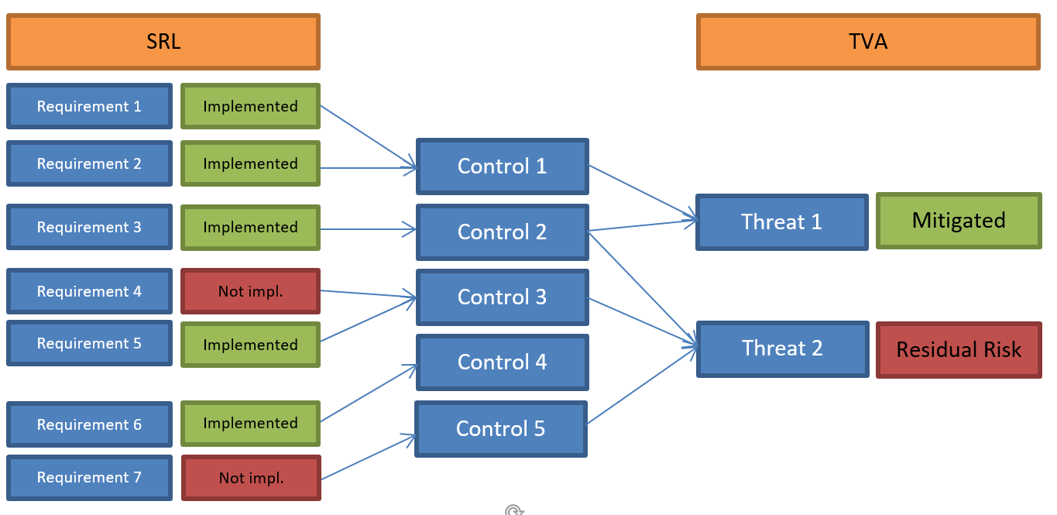
Figure
Fig. 1 - This figure shows how the TVA is 'calculated'. Threat 1 is mitigated by Control 1 and 2, and thus by Requirement 1, 2 and 3. Threat 2 is mitigated by Control 2, 3 and 5 and thus by Requirement 3, 4, 5 and 7
Figure 1 shows how the TVA works in the background. So say that we have implemented requirement 1, 2, 3 and 5. That means that for Threat 1 all mitigating actions that are prescribed by our policies and standards are taken, and the threat is thus sufficiently mitigated. But for threat 2, two requirements are not implemented (nr. 4 and 7) and thus, a residual risk exists.
This residual risk must either be mitigated with additional measures, or the risk can be accepted.
All the measures and residual risks can then be documented in the Security Guidelines.

Slide 17
SUMMARY
We need a predictable risk management environment to fulfill our responsibilities in a more digitalized company acting in a cyber world.
Three Line of Defence
Risk Management Phases
REGULATION ON INFORMATION SYSTEMS OF BANKS AND ELECTRONIC BANKING SERVICES
Risk Assessment

Slide 18
THANK YOU!
Burak DÜNDAR

