Slide 1
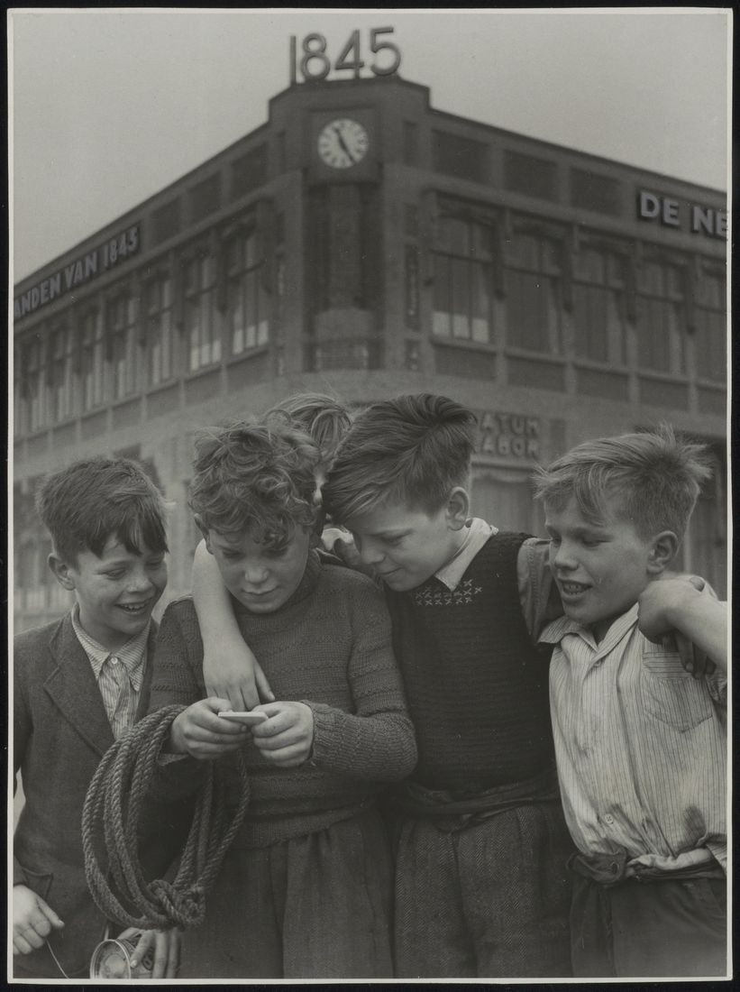
BSO Guidance
Guidance for developing the Business Security Officer
(BSO)
10.06.2021
Version: 1.0

Slide 2
Aganda
BSO - Vision and Strategy
Security starts at the beginning of everything we do
What enables Intertech to get to the desired state?
Business Security Officer
Thank You…

Slide 3
BSO - Vision and Strategy
We need a predictable information security environment to fulfill our responsibilities in a more digitalized company acting in a cyber World.
Mission
Establish a predictable Information Security environment to fulfill DFSG responsibilities
Vision
Information Security by design in our business: people, process and technology

Slide 4
Security starts at the beginning of everything we do. It is not just an IT task and needs to be designed and executed End 2 End.
Security by Design E2E,
Business and IT:
Secure design of business processes, automation in IT, and by encouraging a culture of discipline, ownership and craftsmanship in BU’s and IT.
Executing the DFSG Control Framework
Information Risk and Security is part of the corporate governance framework and assures us the effectiveness of controls (Test of Effectiveness)
Security in -the mind set of- the first line of defense
Executed and budgeted risk and security in the Business Units, strengthen the Business Units to execute their security plan.
Functional reporting lines
for monitoring and assurance reporting by the CISO and the Business Security Officer (BSO) is in place.

Slide 5
What enables Intertech to get to the desired state?
Our journey to the cloud.
Being Agile.
Actively attract top talent
Because we are going to rationalize our application landscape, upgrade our network environment, and move some security services to the cloud provider we are going to use better security cloud solutions.
Small teams, with end-to-end delivery responsibility, enforcement of the automation of processes, upgrading of the skills, capabilities and mindset of our people and including “build security in” in our delivery processes.
to drive our digital transformation and become more digitally customer focused.

Slide 6
Business Security Officer «Different approach requires different skills»
IT Security currently has mostly been approached from IT infrastructure perspective, therefore
Too little focus on controls and security events that really matter to the business. Examples:
User Access verification is executed on all access rules and all deviations require follow up, resulting in backlog in verification and follow up or even worse: pro forma verification (checking the box) rather than actually mitigating risk.
Many security monitoring events reported that are not really significant. Really meaningful event for the business in many cases are missing.
Unstructured data (excel / access apps, documents, data warehouses) containing sensitive data not properly protected.

Slide 7
Business Security Officer Different approach requires different skills
Business Security Officer linking pin between Business and IT security:
BSO should have in depth understanding of business processes and how they are implemented in IT.
Should have a good understanding of business controls
Should be able to translate the relevant business risk and controls in IT security requirements and controls
More a business analyst than and IT engineer
Should report about information (technology) security to local COO/CIO and group CISO

Slide 8
BIS Guidance
Thank You…
10.06.2021
Version: 1.0

